Slide 1
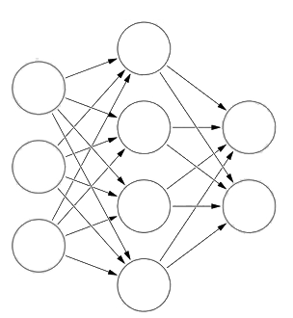
Bilateral Multi-Perspective Matching for Natural Language Sentences - Zhiguo Wang, Wael Hamza, Radu Florian (IBM T.J Watson Research Center)
Korea University,
2016010662 윤주성
2016020743 안진현
AAA606 Natural Language Processing Application

Slide 2
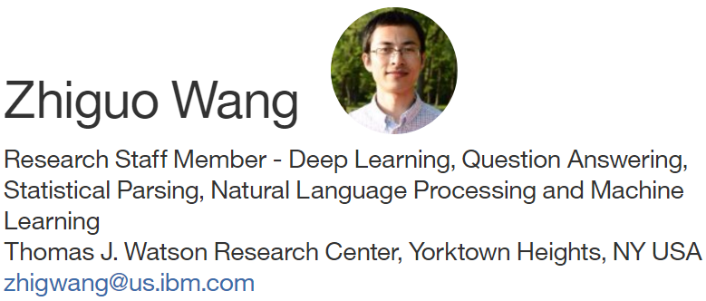
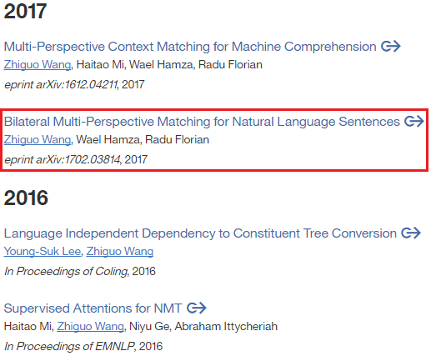

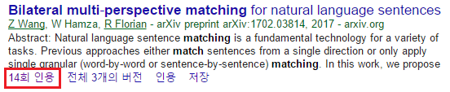
Author
AAA606 Natural Language Processing Application

Slide 3
Intro
Natural language sentence matching (NLSM)
The task of
[1] comparing two sentences and
[2] identifying the relationship between the two sentences
Paraphrase identification [Yin et al., 2015] (determine whether two sentences are paraphrase of not)
Natural language inference [Wang et al., 2016d]
(judge whether a hypothesis sentence can be inferred from a premise sentence)
Answer sentence selection[Wang et al., 2016b] (machine comprehension task / matching QnA)
AAA606 Natural Language Processing Application
Notes:
자신의 논문을..레퍼해서 예를 드는…저자의..

Slide 4




Task Definition
Natural language sentence matching (NLSM)
NLSM Task, can be represented as (P, Q, y)
where (sentence with a length M)
(sentence with a length N)
(label representing the relationship b/w P and Q)
Estimating
Paraphrase identification task
P: sentence 1
Q: sentence 2
Y = {0, 1}
Natural language inference task
P: premise sentence
Q: hypothesis sentence
Y = {entailment, contradiction, neutral}
Answer sentence selection
P: question
Q: candidate answer
Y = {0, 1}
AAA606 Natural Language Processing Application

Slide 5
Task Definition
Sentence example
Quora Question Pairs
Paraphrase identification task
P: sentence 1
Q: sentence 2
Y = {0, 1}
Natural language inference task
P: premise sentence
Q: hypothesis sentence
Y = {entailment, contradiction, neutral}
Answer sentence selection
P: question
Q: candidate answer
Y = {0, 1}
AAA606 Natural Language Processing Application

Slide 6
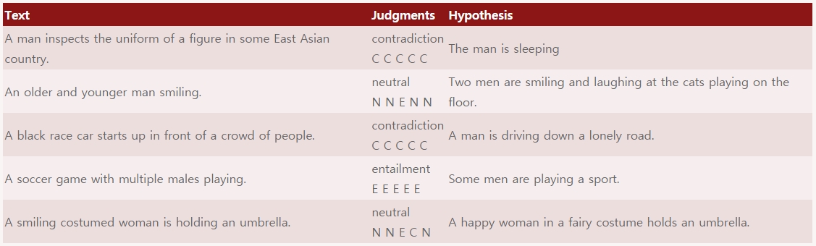
Task Definition
Stanford Natural Language Inference (SNLI)
Sentence example
Paraphrase identification task
P: sentence 1
Q: sentence 2
Y = {0, 1}
Natural language inference task
P: premise sentence
Q: hypothesis sentence
Y = {entailment, contradiction, neutral}
Answer sentence selection
P: question
Q: candidate answer
Y = {0, 1}
AAA606 Natural Language Processing Application

Slide 7
Task Definition
Sentence example
WikiQA
how are glacier caves formed ?
A partly submerged glacier cave on Perito Moreno Glacier .
1
Paraphrase identification task
P: sentence 1
Q: sentence 2
Y = {0, 1}
Natural language inference task
P: premise sentence
Q: hypothesis sentence
Y = {entailment, contradiction, neutral}
Answer sentence selection
P: question
Q: candidate answer
Y = {0, 1}
AAA606 Natural Language Processing Application
Notes:
we used Bing query logs as the question source. Each question is linked to a Wikipedia page that potentially has the answer. Because the summary section of a Wikipedia page provides the basic and usually most important information about the topic, we used sentences in this section as the candidate answers.

Slide 8
Previous / Related Works
“Siamese” Architecture – [Bromley et al., 1993]
The same neural network encoder (CNN, RNN) is applied to two input sentences.
Two sentences -> Two sentence vectors
Advantage:
[1] Sharing parameters (smaller and easier models),
[2] Visualization (sentence vectors),
[3] Clustering
Disadvantage:
[1] No interaction between the two sentences during encoding procedure.
AAA606 Natural Language Processing Application

Slide 9
Previous / Related Works
“Siamese” Architecture – [Bromley et al., 1993]
To deal with this problem,
“matching-aggregation” (저자 논문을 예시로..)
1st match: Smaller units (words or contextual vectors) of P, Q
2nd match: Aggregate the matching results (by CNN or LSTM)
-> Final decision을 위한 vector 생성 (matching vector)
Advantage:
[1] Capture more interactive features between P, Q
Disadvantage:
[1] Only explored the word-by-word matching (phrase-by-sentence 고려x)
[2] Only performed in a single direction ( P -> Q, Not Q -> P))
AAA606 Natural Language Processing Application

Slide 10
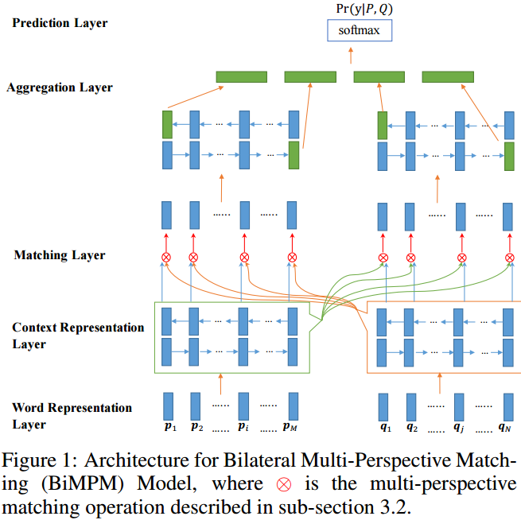
Model
Bilateral multi-perspective matching (BiMPM)
[1] “matching-aggregation” framework
[Wang and Jiang, 2016]
[2] two directions (P -> Q and Q -> P)
[3] Multiple perspectives Matching
(P -> Q and Q -> P)
AAA606 Natural Language Processing Application

Slide 11
Model
Word Representation Layer
The d-dimensional vector with two components:
[1] Word embedding (d = 300)
Pre-trained with Glove or word2vec
[2] Character-composed embedding (d=50)
각 character vector를 word 단위로 LSTM에 넣어서 계산 (many to one model)
Output:
AAA606 Natural Language Processing Application

Slide 12
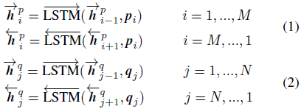
Model
Context Representation Layer
To incorporate contextual information
Using BiLSTM to encode contextual embeddings for each time step
같은 BiLSTM을 사용
AAA606 Natural Language Processing Application

Slide 13
Model
Matching Layer
Each contextual embedding (time-step)
Multi-perspective
Matching operation
All contextual embeddings (time-steps)
AAA606 Natural Language Processing Application

Slide 14
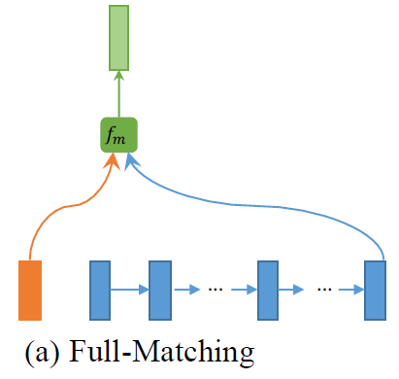














Model
Matching Layer – Multi-perspective Matching Operation
예제) = 3, = 3
Step1. Multi-perspective cosine matching function
$$m_{1}$$
$$m_{2}$$
$$m_{3}$$
$$W_{1}$$
$$\left[\begin{matrix}3 & 4 & 2 \\ −1 & 0 & 0.5 \\ 7 & 0.1 & 5\end{matrix}\right]$$
$$W_{2}$$
$$W_{3}$$
d-dimensional vectors:
$$\left[\begin{matrix}1 \\ 3 \\ 5\end{matrix}\right]$$
Row의 개수==Perspective 개수
$$\left[\begin{matrix}4 \\ 1 \\ 3\end{matrix}\right]$$
trainable parameter:
Number of perspectives:
Matching value from k-the perspective:
Element wise multiplication:
k-th row of W:
AAA606 Natural Language Processing Application
AAA606 Natural Language Processing Application

Slide 15
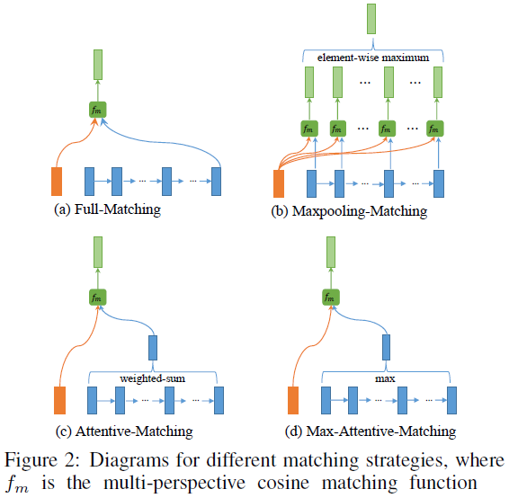
Model
Matching Layer – Multi-perspective Matching Operation
Step2. Four matching strategies
[1] 위의 두 벡터를 어떻게 구성할 것인가 에 대한 전략
[2] Perspective와 Strategy는 다르다
[2-1] Perspective는 vector를 서로 비교할 때 W matrix의 각 row vector를 여러 개 두고 row 개수만큼 feature를 얻어내려는 것을 의미
[2-2]Strategy는 multi-perspective cosine matching function에 vector를 넣기 전 matching을 위한 vector를 선택하는 방법을 의미
AAA606 Natural Language Processing Application
AAA606 Natural Language Processing Application

Slide 16

Model
Matching Layer – Multi-perspective Matching Operation
Step2-1. Full-Matching
Each time step
Last time step
AAA606 Natural Language Processing Application
AAA606 Natural Language Processing Application

Slide 17
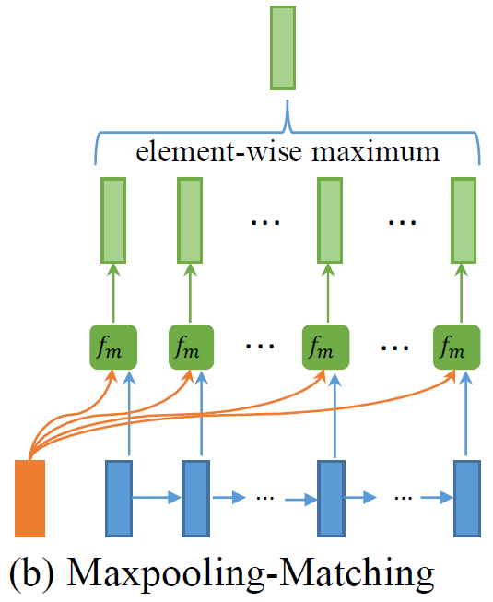
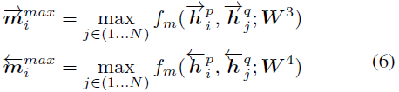





Model
Matching Layer – Multi-perspective Matching Operation
$$\begin{matrix}0.8 \\ 0.9 \\ 0.6\end{matrix}$$
Step2-2. Maxpooling-Matching
$$\begin{matrix}0.8 \\ 0.3 \\ 0.1\end{matrix}$$
$$\begin{matrix}0.3 \\ 0.7 \\ 0.2\end{matrix}$$
$$\begin{matrix}0.1 \\ 0.2 \\ 0.6\end{matrix}$$
$$\begin{matrix}0.1 \\ 0.9 \\ 0.2\end{matrix}$$
Each time step
Every time step
AAA606 Natural Language Processing Application
AAA606 Natural Language Processing Application

Slide 18
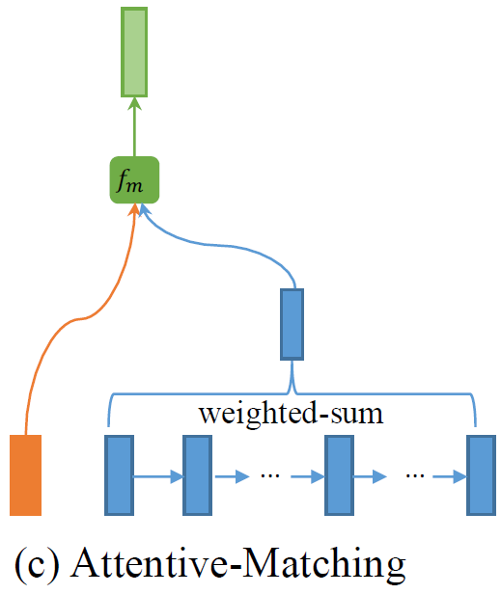
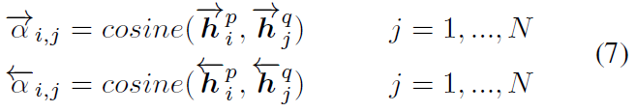
Model
Matching Layer – Multi-perspective Matching Operation
Step2-3. Attentive-Matching
Each time step과 Every time step간의 Cosine 값 계산
AAA606 Natural Language Processing Application
AAA606 Natural Language Processing Application

Slide 19
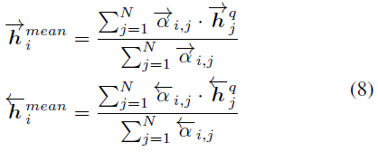
Model
Matching Layer – Multi-perspective Matching Operation
Step2-3. Attentive-Matching
Each time step과 Every time step간의 Cosine 값 계산
Every time step에 대해서 Weighted-sum 계산
AAA606 Natural Language Processing Application
AAA606 Natural Language Processing Application

Slide 20

Model
Matching Layer – Multi-perspective Matching Operation
Step2-3. Attentive-Matching
AAA606 Natural Language Processing Application
AAA606 Natural Language Processing Application

Slide 21
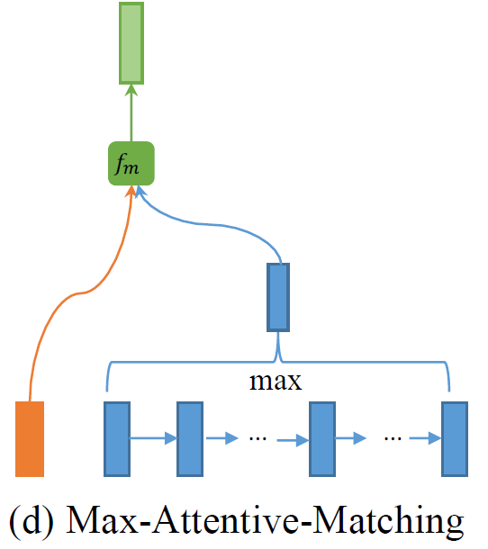
Model
Matching Layer – Multi-perspective Matching Operation
Step2-4. Max-Attentive-Matching
Each time step과 Every time step간의 Cosine 값 계산
AAA606 Natural Language Processing Application
AAA606 Natural Language Processing Application

Slide 22
Model
Matching Layer – Multi-perspective Matching Operation
Step2-4. Max-Attentive-Matching
Each time step과 Every time step간의 Cosine 값 계산
가장 Cosine 값이 큰 time step을 로 선정
AAA606 Natural Language Processing Application
AAA606 Natural Language Processing Application

Slide 23
Model
Matching Layer – Multi-perspective Matching Operation
Step2-5. Matching vector
4 (strategies) x 2 (BiLSTM) = 8
Each time step 마다 총 8개의 vector가 생긴 상태
8개의 vector를 concatenate해서
matching vector 생성
AAA606 Natural Language Processing Application
AAA606 Natural Language Processing Application

Slide 24
Model
Aggregation Layer
matching vector를 fix-length matching vector로 변환하기 위해 Another BiLSTM 사용
BiLSTM의 Last time step 4개를
Fix-length matching vector로 사용
AAA606 Natural Language Processing Application

Slide 25

Model
Prediction Layer
[1] 2 layer feed-forward neural network
[2] Softmax function
[3]
[4] Prediction
AAA606 Natural Language Processing Application

Slide 26
Model
Bilateral multi-perspective matching (BiMPM)
[1] Encode P,Q with BiLSTM
- Word embedding + Character-composed embedding
[2] Matching Layer
- Multi-perspective + matching strategy
- P -> Q matching, Q -> P matching
[3] Aggregation Layer
- Fixed-length matching vector 생성
[4] FC Layer
- Matching vector에 대해 prediction 수행
AAA606 Natural Language Processing Application

Slide 27
Experiments
Experiment Settings
Word embedding
300-dimensional GloVe
840B Common Crawl corpus
Out-of-vocabulary(OOV)
Randomly initialized word embedding
Character-composed embeddings
Initialized 20-dimensional vector
Compose each word into 50-dimensional vector with LSTM
BiLSTM
Set hidden size as 100
Multi-perspective
20 perspectives
Dropout
Ratio as 0.1
Training
Loss as cross entropy
ADAM optimizer (learning rate 0.001)
Do not update the pre-trained word embedding
AAA606 Natural Language Processing Application

Slide 28
Experiments
Experiments & Model properties
[1] Paraphrase Identification
Dataset
- “Quora Question Pairs” dataset
400,000 questions pairs
Brand-new dataset (no previous results)
Dev set
- 5,000 paraphrases and 5,000 non-paraphrases
- Randomly select
Training set
- Remaining instances (399,000 pairs)
Multi-perspectives가 과연 효과가 있을까?
Matching Strategy가 과연 효과가 있을까?
AAA606 Natural Language Processing Application

Slide 29
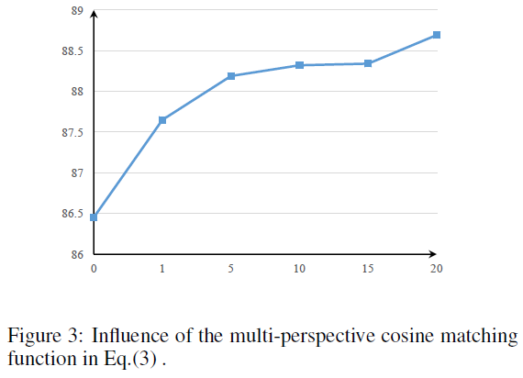
Experiments
Multi-perspectives = {1, 5, 10, 15, 20}
Experiments & Model properties
[1] Paraphrase Identification
Dataset
- “Quora Question Pairs” dataset
400,000 questions pairs
Brand-new dataset (no previous results)
Dev set
- 5,000 paraphrases and 5,000 non-paraphrases
- Randomly select
Training set
- Remaining instances (399,000 pairs)
Baseline (vanilla cosine similarity function)
AAA606 Natural Language Processing Application

Slide 30
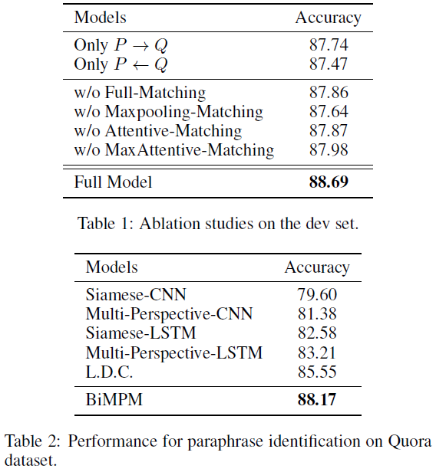
Experiments
Experiments & Model properties
w/o
bilateral matching
[1] Paraphrase Identification
Dataset
- “Quora Question Pairs” dataset
400,000 questions pairs
Brand-new dataset (no previous results)
Dev set
- 5,000 paraphrases and 5,000 non-paraphrases
- Randomly select
Training set
- Remaining instances (399,000 pairs)
w/o
Matching strategies
baseline
AAA606 Natural Language Processing Application

Slide 31
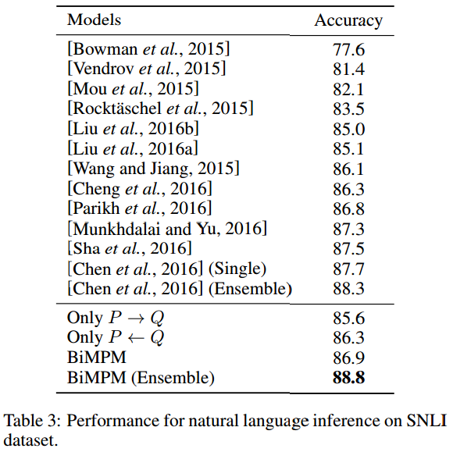
Experiments
Experiments & Model properties
[2] Natural Language Inference
Dataset
- “SNLI” dataset
Four variations of model
“Only P -> Q”
“Only P <- Q”
“BiMPM”
“BiMPM (Ensemble)”
Performance of BIMPM (Ensemble)
- State of the arts
AAA606 Natural Language Processing Application

Slide 32
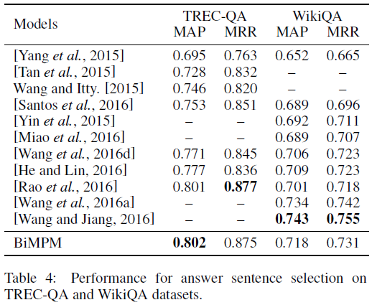
Experiments
Experiments & Model properties
[3] Answer Sentence Selection
Dataset
“TREC-QA” dataset
“WikiQA” dataset
Performance Measure
Mean average precision (MAP)
Mean Reciprocal Rank (MRR)
Evaluation
- With trec_eval-8.0 script
AAA606 Natural Language Processing Application

Slide 33
Conclusion
BiMPM & Contribution
[1] BiMPM model under the “matching-aggregation” framework
[2] Two directions ( P -> Q and P <- Q )
[3] Multi-perspectives
[4] Four matching strategies
[5] the state-of-the-art performance
AAA606 Natural Language Processing Application

Slide 34
Conclusion
BiMPM & Contribution
[1] BiMPM model under the “matching-aggregation” framework
[2] Two directions ( P -> Q and P <- Q )
[3] Multi-perspectives
[4] Four matching strategies
[5] the state-of-the-art performance
AAA606 Natural Language Processing Application

Slide 35
QnA
Thank you : )
AAA606 Natural Language Processing Application

